Slide 1
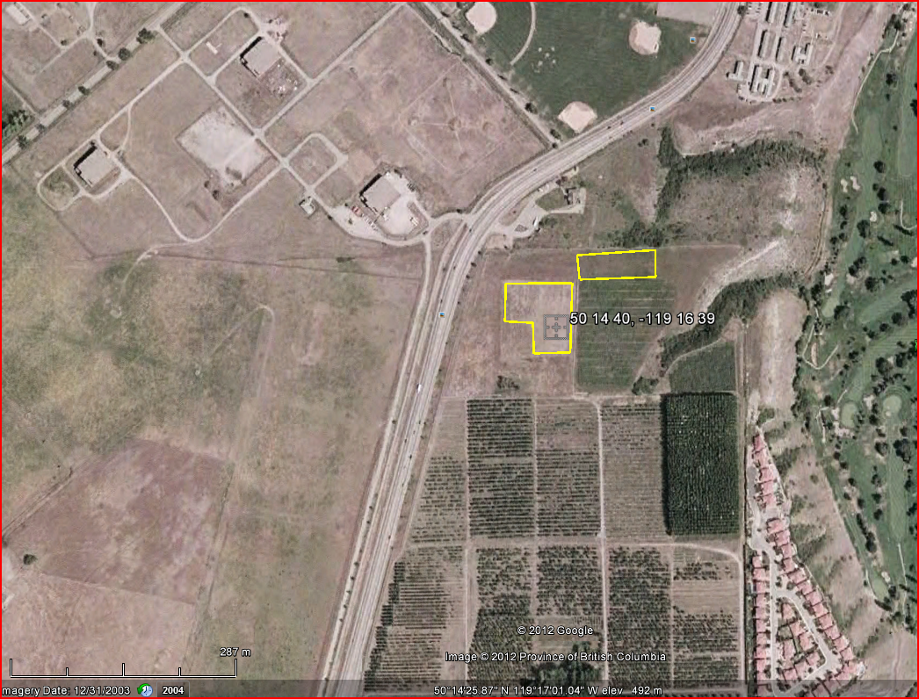
KALAMALKA FORESTRY CENTRE AMAT 2009
EP 1392.06

